Slide 1
TV in the cloud
Richard Craig-mcfeely
14th December 2010

Slide 2
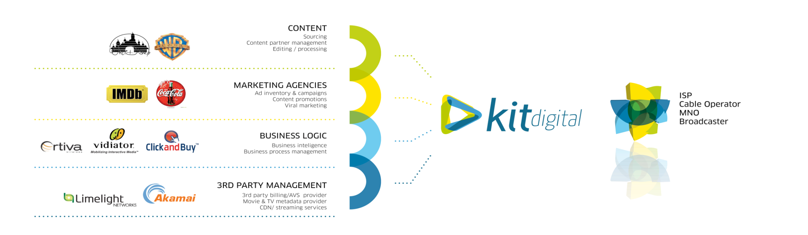
About KIT digital
KIT digital is a leading global provider of video asset management solutions (VAMs) for multi-screen IP-based delivery.
KIT VX-one, the company's family of end-to-end software solutions, enables enterprise clients to acquire, manage and distribute video assets across the screens of today's world: the personal computer, mobile device, IPTV-enabled television set, tablet, digital signage and other connected devices.
KIT is one of the world’s leading players in Broadcast System Integration/Engineering
KIT is also a world class player in Content & Marketing Services.
PLATFORM SERVICES
ISP / Telco
MSO / MNO
Broadcaster
Enterprise
Publisher
Non-Profit
Retailer
Government
Technology
Media
Sport
Faith
INTEGRATION SERVICES
CONTENT SERVICES
MARKETING SERVICES

Slide 3
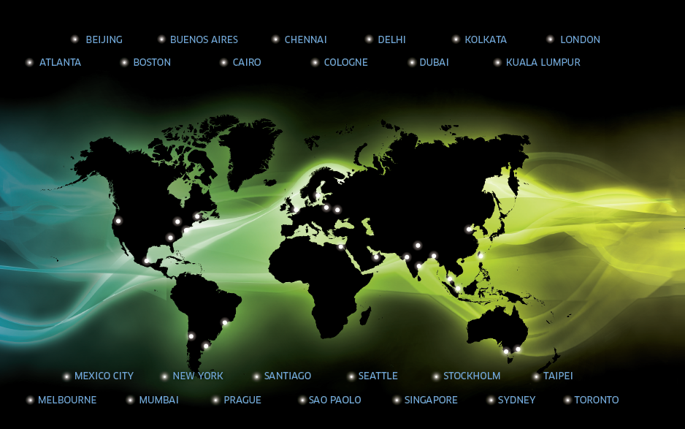
We’ve Got You Covered!

Slide 4
Verticals
Content Owners
Broadcasters
Telcos and Cable Operators
Marketers and Retailers
Corporate Communicators

Slide 5

Over 1200 Customers Globally

Slide 6
1. Video IS now the preferred online media
By 2015, 95% of online data consumed each day will be video
Users have a clear preference for experiencing their news, celebrity and entertainment content
Media organizations as diverse as AP and Perez Hilton are realizing that video must be the centerpiece of their online monetization strategy
Nielsen Report – May 2010

Slide 7
2. Online Video Content Is Trending Towards Long Form
The number of online videos watched in the US declined by 9.2% since April 2009.
Other statistics either stayed roughly the same or increased, indicating that people spend more time watching individual videos.
While YouTube remains the top video site for total video streams, Netflix and Hulu solidly retained the top-ranked spots for time spent per viewer.
Nielsen Report – May 2010

Slide 8
3. The Internet and TV Are Becoming Friends
NBC, FOX and ABC came together to create online video platform Hulu.
Netflix revealed video streaming support to multiple platforms including Internet connected TV sets, TV’s through set-top-boxes, various game consoles and other devices.
Roku set-top-box started streaming NBA, MLB games, Pandora music, Amazon on demand and Netflix video to TV sets.

Slide 9
4. High Speed Internet Access Is Getting Cheaper and More Prevalent
Broadband Internet prices decreased 42% last year across 161 countries worldwide.
26% of the world population, or 1.7 billion people, were using the Internet last year.
The number of broadband subscribers in the Asia Pacific Region will grow at an estimated 15% five-year compound annual growth rate (CAGR) between 2009 and 2013.
United Nations, Strategy Analytics (2010)

Slide 10

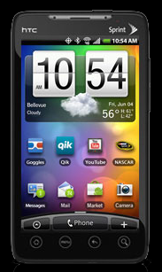



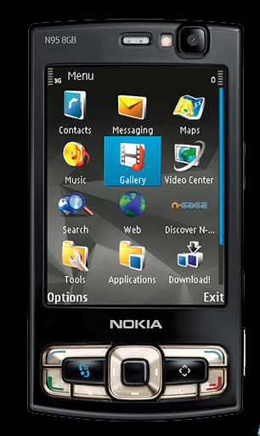
Complement not compete…
Rather than competing for viewer’s attention, various devices are beginning to complement each other. Content can be accessed anytime, anywhere, anyhow. A mobile device can be a video player as much as a remote control for your Internet connected TV.

Slide 11
Television
Telecommunications companies can now be broadcasters, and can stream content through a dedicated set-top-box, integrate content into an existing hybrid set-top-box or deliver it directly to an Internet connected TV.
Familiar cable TV channel browsing experience and even more elaborate functionalities can be developed to fit needs and optimize user experience.

Slide 12
Web Browser
Elaborate online video viewing experiences can be built and supported by an online video platform.
While primarily used to access online video content through the computer, web browser can be utilized as a remote content management tool for an Internet or set-top-box connected TV.

Slide 13
Mobile Devices
Device-optimized user interfaces can be built.
Dynamic bitrate adaptation can be applied where mobile signal is unstable.
Video stream can be picked up from the place a viewer left it on his TV set.
Mobile devices allow you to view, remotely control, share, rate and schedule content.

Slide 14
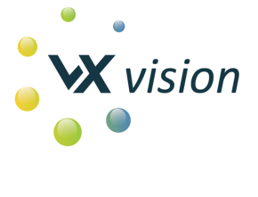
VX Vision
Broadcast-centric software platform capable of delivering to multi-screen environments
SaaS
Connected Devices
Set Top Boxes
Roku
Connected TVs
Game Consoles
Web and Mobile
Notes:
Key Learning Points
Key module within the KIT digital software platform
Especially applicable to content owners and distributors that want to deliver their content in a broadcast-centric manner via WebTV or MobileTV interfaces
Can deliver content to virtually any output device: Web, Mobile Devices, Connected Devices
NOTES:________________________________________________________________________________________________________________________________________________________________________________________________________________________________________________________________________________________________________________________________________________________________________________________________

Slide 15
VX Vision Target Market
Television broadcast channels
Satellite service providers
Cable MSOs
Companies looking to provide OTT (Over the Top) IPTV services
Any company looking to provide its video content in a channel or program “broadcast like” environment
Notes:
Key Learning Points:
VX Vision is suited to customers that already provide their content in a “broadcast like” environment, such as television channels satellite providers or cable operators, but is also great from companies that WANT to distribute their content in manner that feels like television – for example:
Newspapers
Radio Stations
Corporations with large content libraries
NOTES:________________________________________________________________________________________________________________________________________________________________________________________________________________________________________________________________________________________________________________________________________________________________________________________________

Slide 16



Content Ingestion
User encoding to an FTP site
Encoding.com
JPEB
Notes:
Key Learning Points
Content can be ingested into the VX Vision software environment via a variety of methods including:
User encoding and delivery to an FTP location creating multiple files
Encoding.com – industry standard cloud based encoding system
JPEB – Cloud based encoding solution provided by KIT digital
Uploaded media is automatically encoded into the necessary file formats
Uploaded content appears in the media pending queue until the content is registered and allocated into Packages to be used to create Programs.
NOTES:________________________________________________________________________________________________________________________________________________________________________________________________________________________________________________________________________________________________________________________________________________________________________________________________

Slide 17
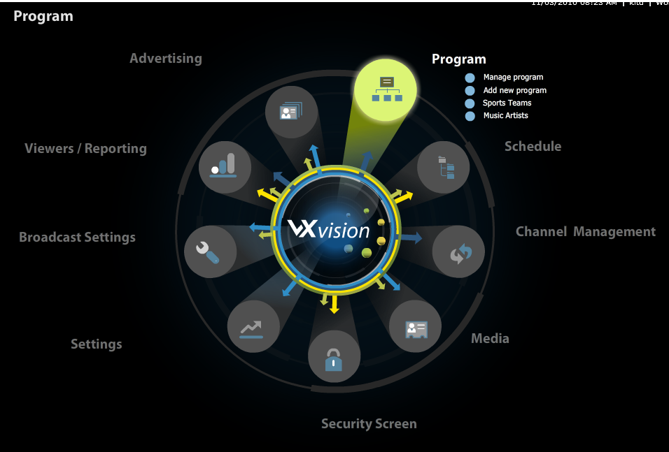
Content Management System
Notes:
Key Learning Points
Content owners need a way to organize and deliver their content in an efficient, intuitive way. The VX Vision CMS enables content owners to fully manage their content themselves (even if they are not engineers), or KIT digital can provide a fully managed service if required.
The VX Vision CMS handles media assets as individual units or in groups.
Components of VX Vision CMS – “The Dashboard”
Program – Ability to add and manage programs
Schedule – Creation and management of linear play-out schedules
Channel Management – Manage video on demand and live shows for channels
Media – Configure files, live media streams, advertising and rule-based media
Security Screen – Manage login details and permissions of users and groups
Settings – Modify system setting for media servers, video folders and country server
Broadcast Settings – Control the settings for channels, affiliates and broadcasters
Viewers/Reporting – Menu allows access to premium viewer reporting features
Advertising – Enables content managers to add and set up advertisement policies

Slide 18
Media Assets & Packages
Media Assets – any individual content element
Packages - collection of media assets with the same content, but different formats and bit-rates
Notes:
Key Learning Points
Each piece of content is encoded, or transcoded, into the required formats for distribution to the required output devices
Media Assets – any individual content element
Video
Advertisement
Idents
Bumpers
Packages - collection of media assets with the same content, but different formats and bit-rates to support different devices and user environments, like different types of mobile devices, web browsers, connected devices, etc.
NOTES:_________________________________________________________________________________________________________________________________________________________________________________________________________________________________________________________________________________________________________________________________________________________________

Slide 19
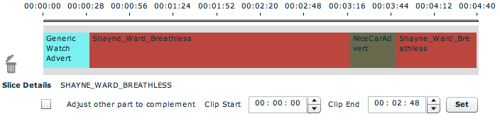
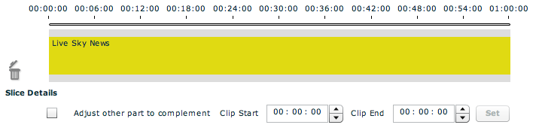
Programs
Same concept as a “television program”
VOD , Live broadcast or combination of content, advertising or other media assets
Notes:
Key Learning Points
The main source of play out in VX Vision is called a Program.
Programs consist of both content and metadata (descriptive information about the media asset attached to the asset and searchable in the system) and can be:
A simple set of files representing a VOD file
A Live broadcast of a single event such as a soccer game or concert
A more complex set of Content, Advertising, Idents and Bumpers
NOTES:_______________________________________________________________________________________________________________________________________________________________________________________________________________________________________________________________________________________________________________________________________________________________________________________________

Slide 20
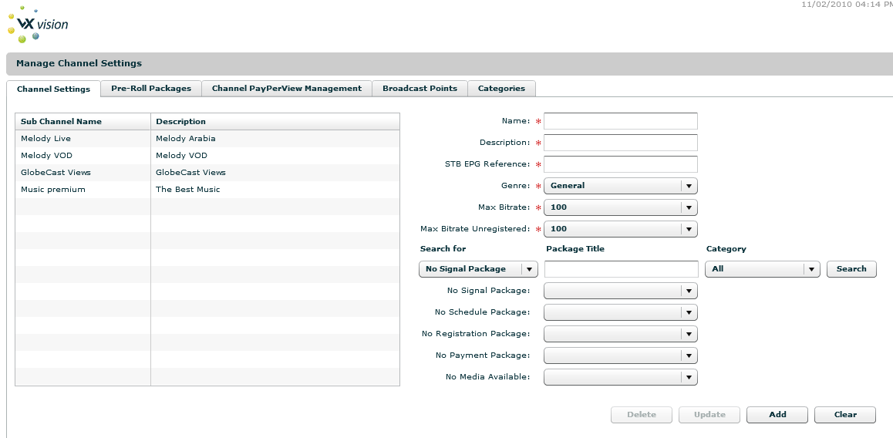
Channels
Once Programs are created in VX Vision, they need to be published to Channels
Notes:
Key Learning Points
By selecting one of the channels within VX Vision, it is possible to configure the channel settings:
Channel Name – Name of the Channel
Description – Channel Description
EPG – The Electronic Program Guide (EPG) number used for selection on Set Top Box or Connected TV systems.
Genre – Type of Channel such as Sports, News, Drama
Max Bit-rate – the maximum speed of content that will be used to cap playback
Max bit-rate Unregistered – maximum speed of content that will be used if the viewer has not registered and has a site based identifier
NOTES:________________________________________________________________________________________________________________________________________________________________________________________________________________________________________________________________________________________________________________________________________________________________________________________________

Slide 21
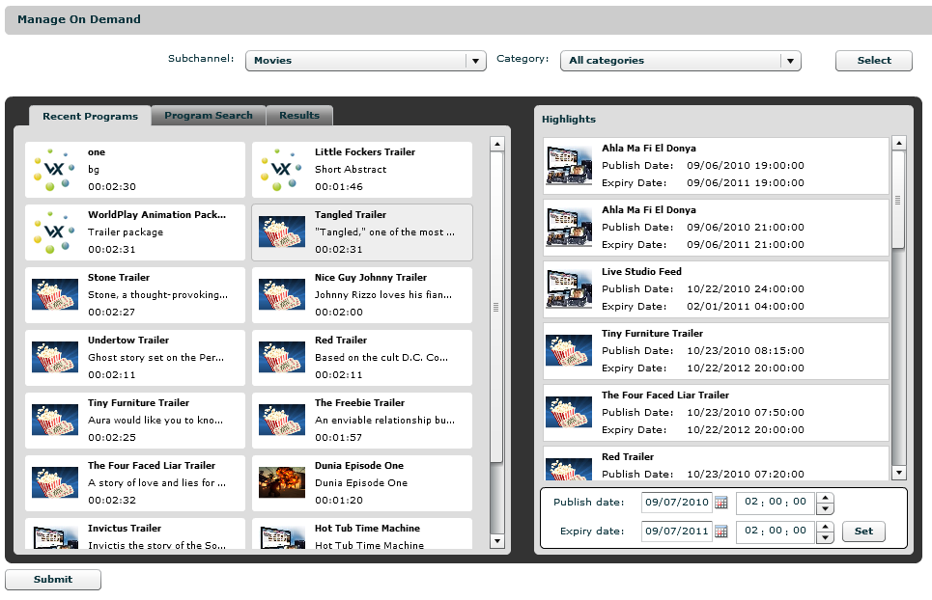
VOD Channels
Notes:
Key Learning Points
Each channel can have multiple Video on Demand Categories
Each of the Categories can have a number of Programs added to the list. When a Subchannel is selected, the currently configured list of content is displayed
It may be necessary to modify and override a Program’s Publication and Expiration dates for an individual channel where the channels are assigned to different affiliates. Each of the channels, or affiliates, may have different rights allocated, and therefore different publishing rules. For example:
The channel UK Sky can play soccer highlights 6 hours after kick off
Portsmouth FC can play highlights the next day at midnight
The ability to set different publishing rules for each channel is an important capability to ensure that the copyright holders’ regulations are respected
NOTES:________________________________________________________________________________________________________________________________________________________________________________________________________________________________________________________________________________________________________________________________________________________________________________________________

Slide 22
Live Channels
A live feed uses the same approach as Video on Demand in that a number of streams are collected together in a package with different formats:
Windows Media – RTSP client side or server side URL
Flash H.264 - normally RTMP feed representing up to three different bit-rates
3GP – RTSP Mobile Handset CDN
M3U8 – HTTP streaming link for iDevices, Mobile Proxy, Set Top Box and Connected TV.
Notes:
Key Learning Points
If the channel is a live broadcast channel, it is possible to configure the broadcast server point that allows connection to the stream 24 x 7 and relay of the live signal.
We recommend that these packages have pre-determined lengths of approximately 60 minutes. If a longer broadcast is required, these packages can simply be joined together in 60 minute segments later when a program is configured.
The system also allows local broadcasting via multicast settings on a LAN or WAN that can support end-to-end multicast broadcasting. This is useful for closed “walled garden” broadcasting to multiple devices.
NOTES:________________________________________________________________________________________________________________________________________________________________________________________________________________________________________________________________________________________________________________________________________

Slide 23
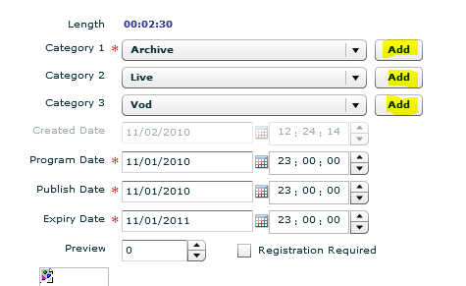
Categories
Programs can be sorted into searchable categories:
Movies
VOD
Archive
Live
Any custom category can be entered into the system
Notes:
Key Learning Points
Content owners with small or large video libraries can manage the search process within the VX Vision CMS
Programs can be sorted into preloaded categories as well additional, customized categories which can be added as needed
NOTES:________________________________________________________________________________________________________________________________________________________________________________________________________________________________________________________________________________________________________________________________________

Slide 24
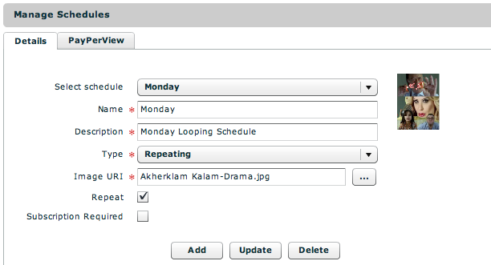
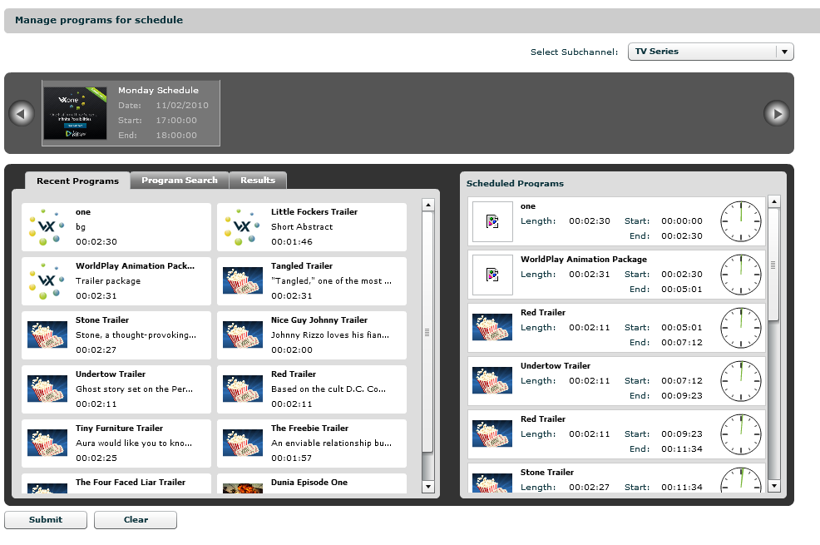
Playlists & Schedules
Notes:
Key Learning Points
Each Channel can have a number of schedules that can be configured in blocks of 24 hours, which can then be assigned to a channel with a specific start and end time.
If there is a limited amount of content, a 24 hour schedule can be created that does not have a full 24 hours of content. The system can be configured to loop when the end of programming content is reached in order to fill the 24 hour slot
An unlimited number of schedules can be created in VX Vision
After creating a Schedule, users can add Programs to that Schedule.
The Video Player determines the correct time of day to start the video playback, as well as the correct point in the video stream, if the content is part way through when the schedule begins
NOTES:________________________________________________________________________________________________________________________________________________________________________________________________________

Slide 25
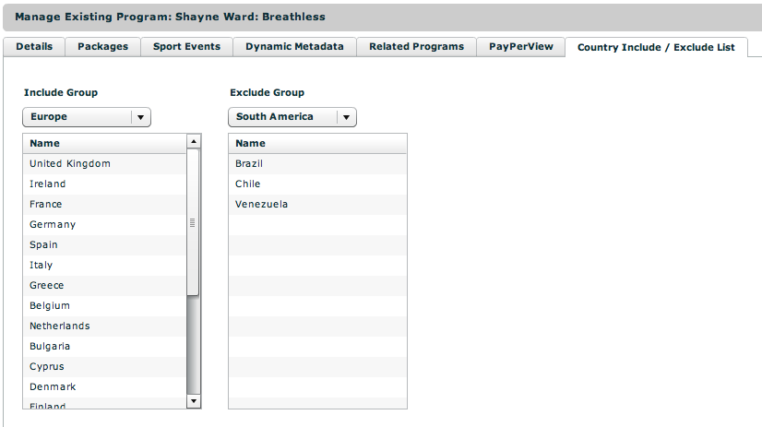
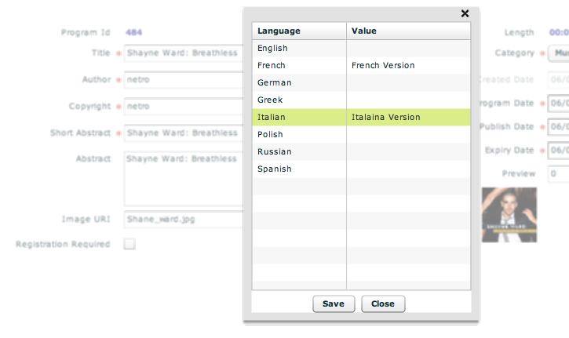
Geo-Blocking & Multi-Language Support
Content rights can be protected by including or excluding the content from certain territories
Users are also able to configure additional languages for Programs
Notes:
Key Learning Points
Content rights content can be protected by including or excluding the content from certain territories. Territories can be configured based on exiting regional and national boundaries.
Include Groups can be customized to include only the countries desired for the content specified. For example if a sponsor only wanted to broadcast in four particular countries, a new include group could be created using the Sponsor Name as a territory and then adding the countries to this territory.
Note that if no Exclude Group is created the content will only show in the Include Countries. If an Exclude Group is configured the content will play in all locations except the excluded groups. The Video Players use IP addresses for recognizing the viewer’s location and determining whether or not to play the content. If content is excluded from a region, VX vision automatically plays content based on the regional channel configuration.
VX Vision provides users with the ability to deliver content in multiple languages

Slide 26
Advertising
Content owners want & need to monetize their content
For delivery to any screen, VX Vision can integrate with external advertising solutions
VX Vision supports the VAST standard
OAS
DART
Pre- and post-roll
Insertional ads at any point in a program
VX Vision can also act as an advertising engine
Notes:
Key Learning Points
Content owners and distributors are looking for ways to monetize the investment they have made in creating or purchasing content. Their content is a “hook” for stickiness in their customer base, keeping their customers coming back for more versus moving to their competition.
Support for multiple advertising engines that support the VAST standard with the primary support for OAS and DART
Rule-based advertising to allow inventory such as video banners to be uploaded at any point in a program, via the cue point editor in the CMS, and played at specific points in the video playback experience
Campaigns can be targeted at channel or program level with support for multiple engines at all levels
Inventory managed by VX Vision or external advertising engines
Advertising pre-rolls, insertional, overlay, post-roll managed in multi-device approach
VX Vision system can replace content and act as an advertising engine. By ingesting advertising media into the system, it is possible to create simple scripting rules that will be evaluated at runtime based on information that is supplied by the player. Any information that can be passed by the player such as Sex, Age, and Location, can then be used as part of the rule.

Slide 27


Content Protection & DRM
Content Protection uses Secure Steam technology & encryption
DRM uses industry standards
Microsoft Playready
Verimatrix
Windows Media DRM 10
Notes:
Key Learning Points
Content Protection
Adopted by leading broadcasters as alternative to DRM
Live stream protection using Secure Stream technology and encrypted delivery
VOD and Live URL token security and URL expiration
Digital Rights Management (DRM)
DRM encryption of content
Storage of encrypted and original source content
License provision and license server
License model for subscription and download-to-own services
Mixed technology to include Microsoft Playready (Silverlight player), Windows DRM (Windows Media player) and Verimatrix (web player, iDevice players, set top box)
NOTES:________________________________________________________________________________________________________________________________________________________________________________________________________

Slide 28
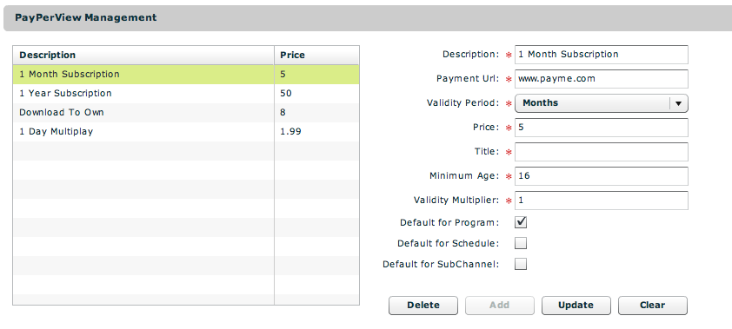
Billing & Subscription Solutions
Content owners & distributors want to monetize their content
Variety of subscription models: PPV, Days, Weeks, Months, Years
PayPal, MGt and other 3rd party integrations possible
Notes:
Key Learning Points
Each payment item can have the following information configured:
Description – User provided description to identify the payment option
Payment URL – Configuration of script to embed an instant payment script, such as PayPal BUY NOW buttons
Validity Period – one of the available validity periods that include Minutes, Hours, Days, Months and Years
Price – Actual cost of the payment option
Minimum Age – Age restriction for the content and payment option
Validity Multiplier – Multiply the base validity period, for example 5 Minutes or 30 days
Default options– Is the payment the default for Program, Schedule or Channel
If any content is recognized as Premium, and it has a payment option specified, then it is possible for the players to display and request payment options from the viewer
Presentation of pricing can be specific for channels or individual programs
Collection of payment using PayPal to nominated PayPal account, thus allowing credit card or checking account withdrawal for payments
Ability to integration with other 3rd party billing providers and pay wallet solutions providers, such as MGt. Integration will be completed on a custom development basis
Registration of viewers for billing options is possible using the internal Viewer Data Base Management Systems or via linking to external Viewer CRM Management via CRM optional interfaces

Slide 29
EPG – Electronic Program Guide
VX Vision enables ingestion of EPG for web or mobile players.
Ingested from XML or Microsoft Excel file formats
The EPG can be modified in the VX Vision CMS backoffice
Dependent on player with linear guide including:
Playing Now
Coming Next visual interfaces
Notes:
Key Learning Points
The Electronic Program Guide (EPG) can be ingested from XML or Microsoft Excel file formats (more fully described in the VX Vision User Guide)
The EPG can be modified in the VX Vision CMS back office
Presentation of the EPG is dependent on player design and can be viewed as Linear Guide including Playing Now, Coming Next visual interfaces
NOTES:_______________________________________________________________________________________________________________________________________________________________________________________________________ _

Slide 30


Content Delivery Networks (CDN)
VX Vision is CDN agnostic
Akamai
Limelight
Level 3
Vidiator – Mobile RTSP CDN
Ortiva – Mobile RTSP CDN
Private CDN
Other CDN partner integration as required
VX Vision can utilize other CDN provided services
Ex: Akamai Dynamic Site Acceleration (DSL) or geo-blocking services
Notes:
Key Learning Points
KIT digital has negotiated good CDN rates that can be bundled together with Vision pricing
Additionally, KIT can help negotiate special pricing
VX Vision is CDN agnostic – virtually any CDN partner can be integrated (with the proper time and planning) to deliver content
NOTES:_______________________________________________________________________________________________________________________________________________________________________________________________________

Slide 31
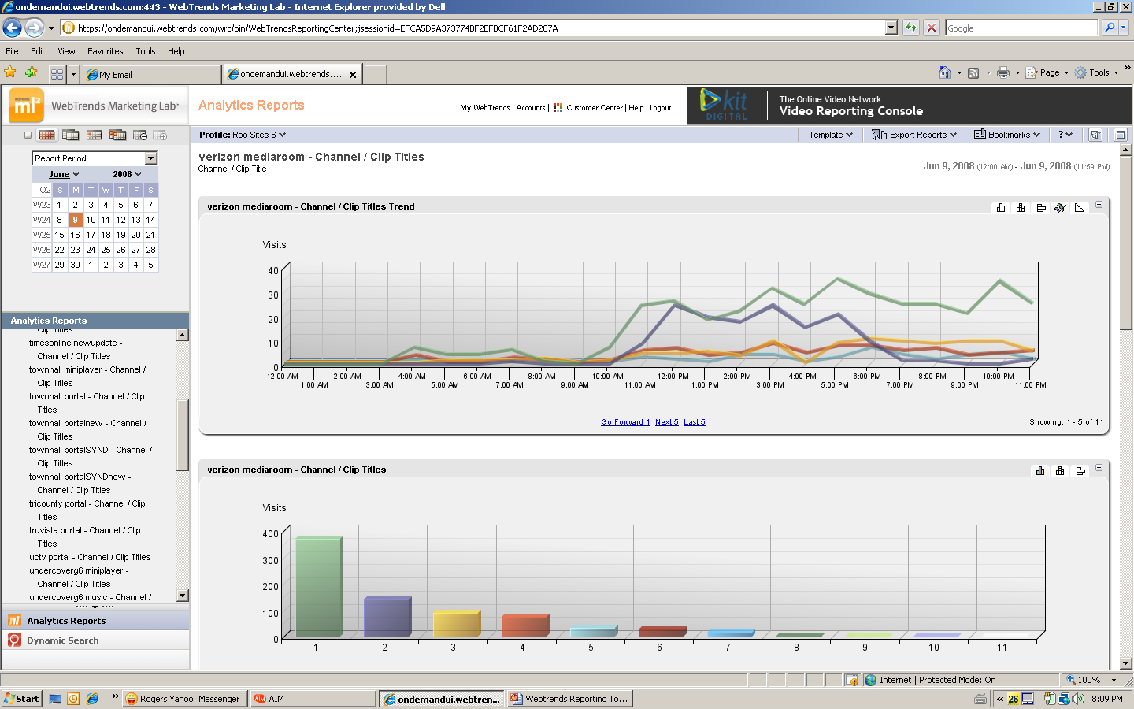
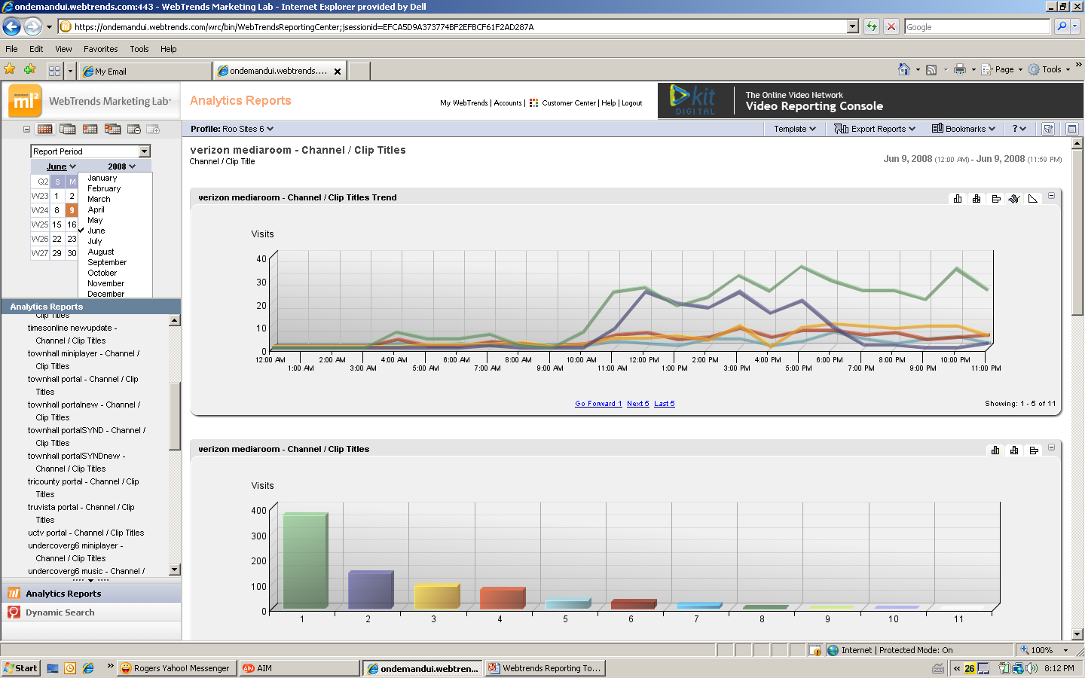
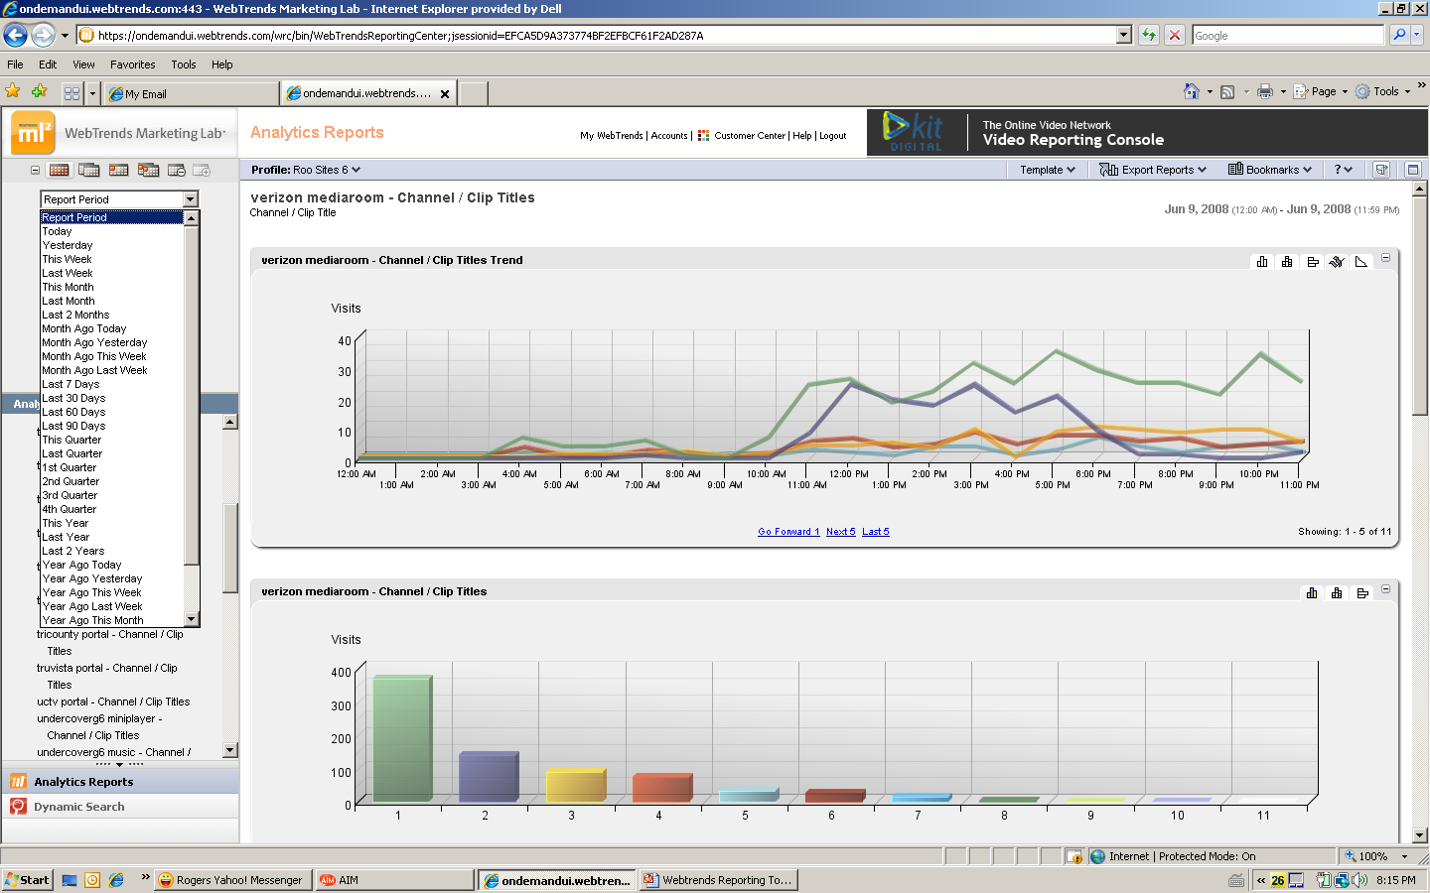
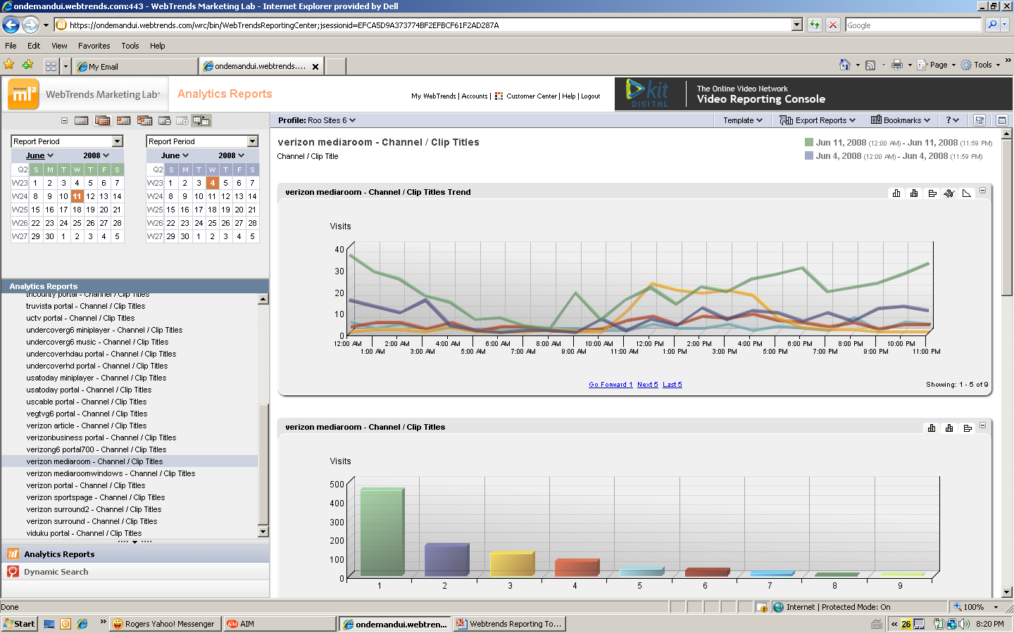
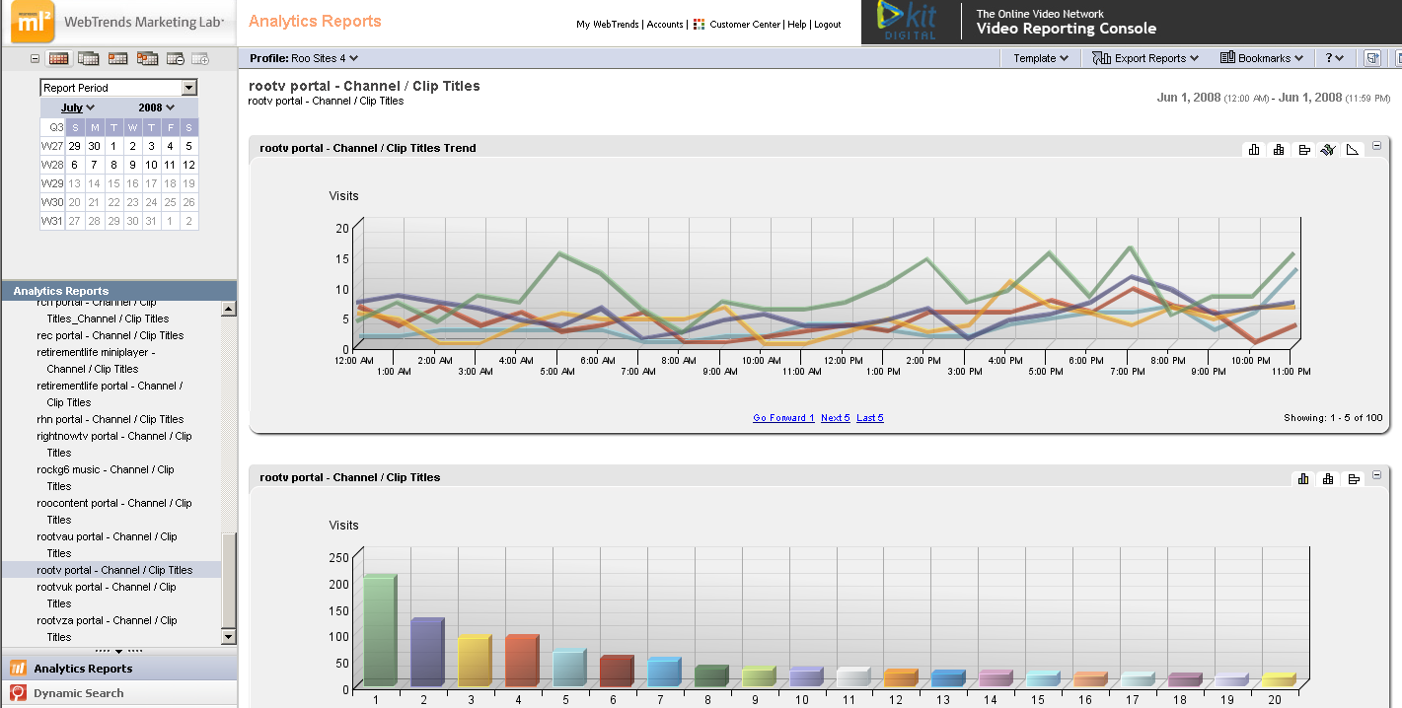
Reporting – WebTrends
Notes:
Key Learning Points
KIT digital uses WebTrends to provide analytics and reporting to the clients.
WebTrends is an industry leading reporting tool that provides reliable, impartial and accurate measurement of your player statistics and audience engagement.
Users will have online access enabling them to:
Log in 24/7 to view your statistics
Export Reports in different available formats
View statistics by day, month or custom date range
Schedule auto report export (daily/weekly/monthly), delivered to you by email, FTP, etc.
NOTES:________________________________________________________________________________________________________________________________________________________________________________________________________

Slide 32


KIT case study: TV2MORO

Slide 33
TV2MORO’S BUSINESS NEEDS
TV2MORO recognized that as broadband connectivity increased in the US, a unique opportunity was emerging in the subscription TV market:
Ethnic content, typically delivered via a satellite dish was increasing in demand
The propensity for this audience to live in high-density housing means that satellite installation is challenging and sometimes impossible
Delivering TV channels over IP (IPTV) can provide a cheaper, more reliable service to an untapped segment of the market
In order to realize this demand, TV2MORO needed a technology partner to provide an end to end platform signal acquisition and streaming, customer management, and set top box interface and playout.
Since 2008, KIT digital has been right alongside TV2MORO, partnering with them as they built the business.

Slide 34
KIT’S SOLUTION
KIT digital provided an end-to-end product, operating, and marketing solution to deliver TV2MORO’s content to its customers in the US:
Deployment of two IPTV set top boxes with wireless USB and PVR and a Linux-based operating system
Satellite capture of live stream with IP delivery, with playout supporting Windows Media DRM and H.264 codec
Open standard middleware and user interface solution, plus integration and management of industry-leading CDN provider
Operating solution:
Deployment of full customer relationship management application
Integration of customer-facing online payment gateway, fulfillment and inventory management application
Customizable reporting tool for content providers
24/7 Tier 2 customer support

Slide 35
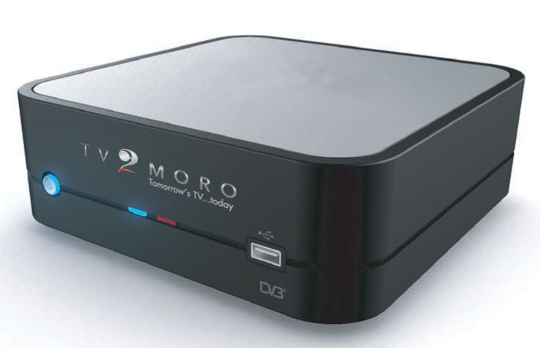
KIT’S SOLUTION CONTINUED
Marketing solution:
Creation of corporate branding bible and guidelines
Scope and design of corporate logo and other administrative elements
Design and build of corporate website
Design and build of set top box graphical user interface

Slide 36
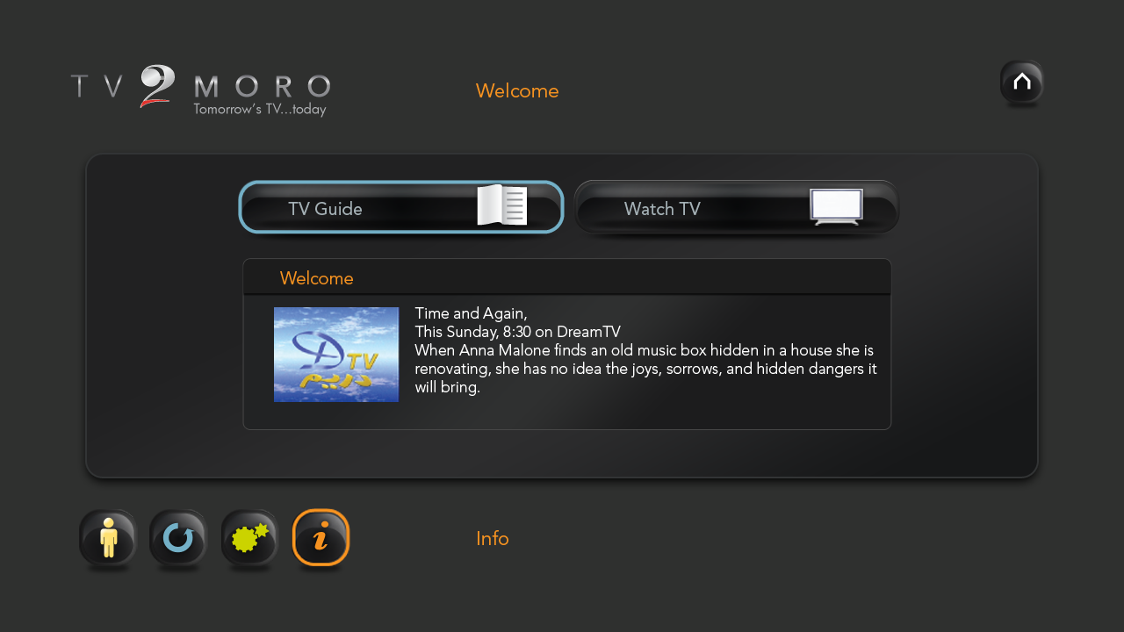
KIT’S SOLUTION – GRAPHICAL UI

Slide 37
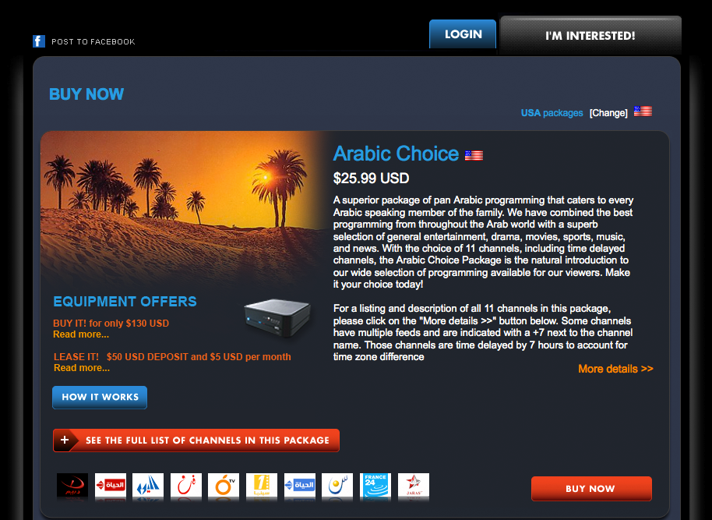
KIT’S SOLUTION – GRAPHICAL UI

Slide 38

KIT case study: OViVO / PMT

Slide 39
PMT’S BUSINESS NEEDS
Personal Media Technologies LLC (PMT) saw an opportunity to revolutionize the way people view television, and sought a robust and scalable platform to make their vision a reality:
The television viewer has to watch what is scheduled, not taking into account whether he likes it or not
A better system would offer the viewer a personalized playlist of programs available live and on-demand based on their viewing preferences, history, and demographics
Content could be monetized with demographic- and interest-targeted ads, allowing advertisers to deliver personalized advertisements to their target audience
To realize their vision, PMT needed a technology partner to provide a state of the art solution combining content management and scheduling, state of the art recommendation engine, and easy set-top-box integration.
KIT digital has been PMT’s premier technology partner since 2009.

Slide 40
KIT’S SOLUTION
“OViVO” is PMT’s personalized digital TV platform in the Russian market, the first large step towards next-generation television.
The offering organizes a user's TV viewing for them, analyzing viewing choices and learning what a viewer likes and dislikes.
KIT digital has partnered with Digsoft to create the Ovivo solution
OViVO is delivered via KIT digital’s VX video management platform, providing:
Tens-of-thousands of hours of in-demand, user-targeted video content
A recommendation engine that delivers a personalized viewing experience
Integration with and management of ad-serving engines, allowing advertisers to deliver targeted advertisements
KIT digital once again proves that it is the global partner of choice in the development of enterprise-level, industrial-grade IP video technology for large audiences.

Slide 41
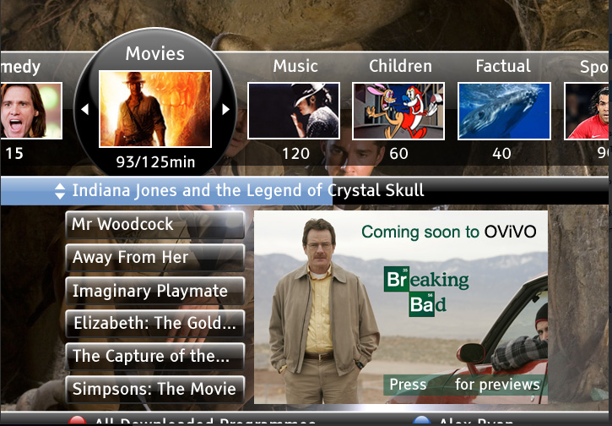
KIT SOLUTION CONTINUED

Slide 42
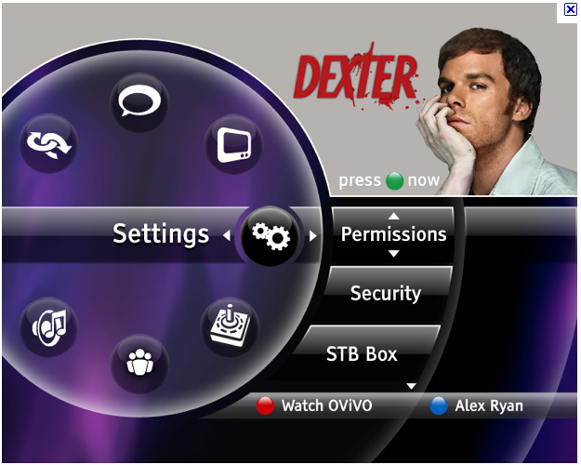
KIT’S SOLUTION CONTINUED

Slide 43
Final words
Massive move to online in all its forms by all players in the media space
TV already exists in the cloud
KIT digital is a major player in the OVP space + broadcast + content & marketing services
Come and talk with us!

Slide 44
Thank you!
Richard Craig-mcfeely
rcm@kitd.com

Slide 45
SPARE

Slide 46
THE RESULTS
The OViVO service has proven extremely popular with users in Russia looking for a more personalized media experience
OViVO is planning to expand to other markets from 2011
Subscriber numbers are confidential, but the service is one of the most of profitable examples of IPTV in Russia today
KIT digital and Digisoft continue to collaborate on other customer work

Slide 47
Online Video Is Trending Towards Long Form
The number of online videos watched in the US declined by 9.2% since April 2009.
Other statistics either stayed roughly the same or increased, indicating that people spend more time watching individual videos.
While YouTube remains the top video site for total video streams, Netflix and Hulu solidly retained the top-ranked spots for time spent per viewer.
Nielsen Report – May 2010

Slide 48
The Internet and TV Are Becoming Friends
NBC, FOX and ABC came together to create online video platform Hulu.
Netflix revealed video streaming support to multiple platforms including Internet connected TV sets, TV’s through set-top-boxes, various game consoles and other devices.
Roku set-top-box started streaming NBA, MLB games, Pandora music, Amazon on demand and Netflix video to TV sets.

Slide 49
User Experience Is Becoming Top Priority
Kylo released the world’s first browser designed specifically for HDTV.
Google TV unveiled its video indexing and IPTV platform.
Adobe CEO committed to providing “great tools to help sites optimize and repurpose their content” for TV screen.

Slide 50
High Speed Internet Access Is Getting Cheaper….
Broadband Internet prices decreased 42% last year across 161 countries worldwide.
26% of the world population, or 1.7 billion people, were using the Internet last year.
The number of broadband subscribers in the Asia Pacific Region will grow at an estimated 15% five-year compound annual growth rate (CAGR) between 2009 and 2013.
United Nations, Strategy Analytics (2010)

Slide 51
Tech Heavyweights Are Stepping In To Innovate
While Apple TV was considered company’s “hobby project”, recently announced Google TV will push both companies to pay closer attention to their IPTV strategies.
Internet connected TV’s from Sony, LG, Samsung and other manufacturers are blurring the line between web and TV experience.

